Slide 1

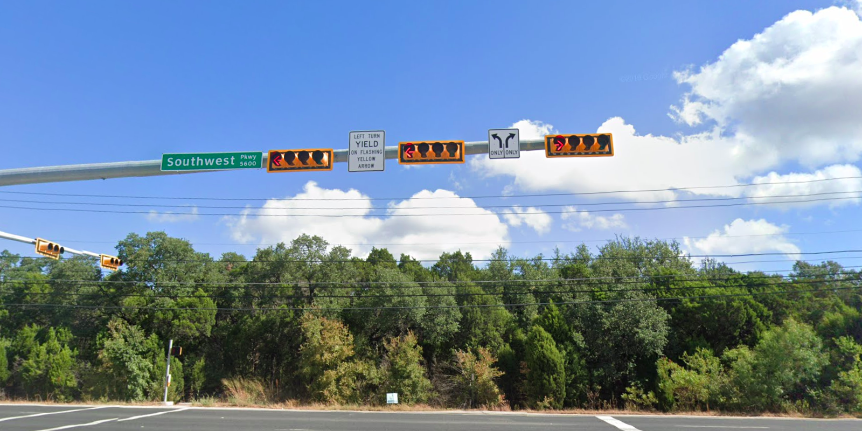
Austin Transportation Department Signs Work Orders
Created By: Susanne Gov Created Date: 2020-08-10 Location Name: 5613 BLK SOUTHWEST PKWY (Encino Trace Office Park) Intersection ID: 0 Cardinal Direction: N
Sign Type | Install/Remove
Left Turn Arrow Only | Install
Street Name Sign | Install
Left Turn Yield Flashing Yellow | Install
Right Arrow Only | Install

Slide 2
Austin Transportation Department Signs Work Orders
Created By: Susanne Gov Created Date: 2020-08-10 Location Name: 5613 BLK SOUTHWEST PKWY (Encino Trace Office Park) Intersection ID: 0 Cardinal Direction: S
Sign Type | Install/Remove

Slide 3
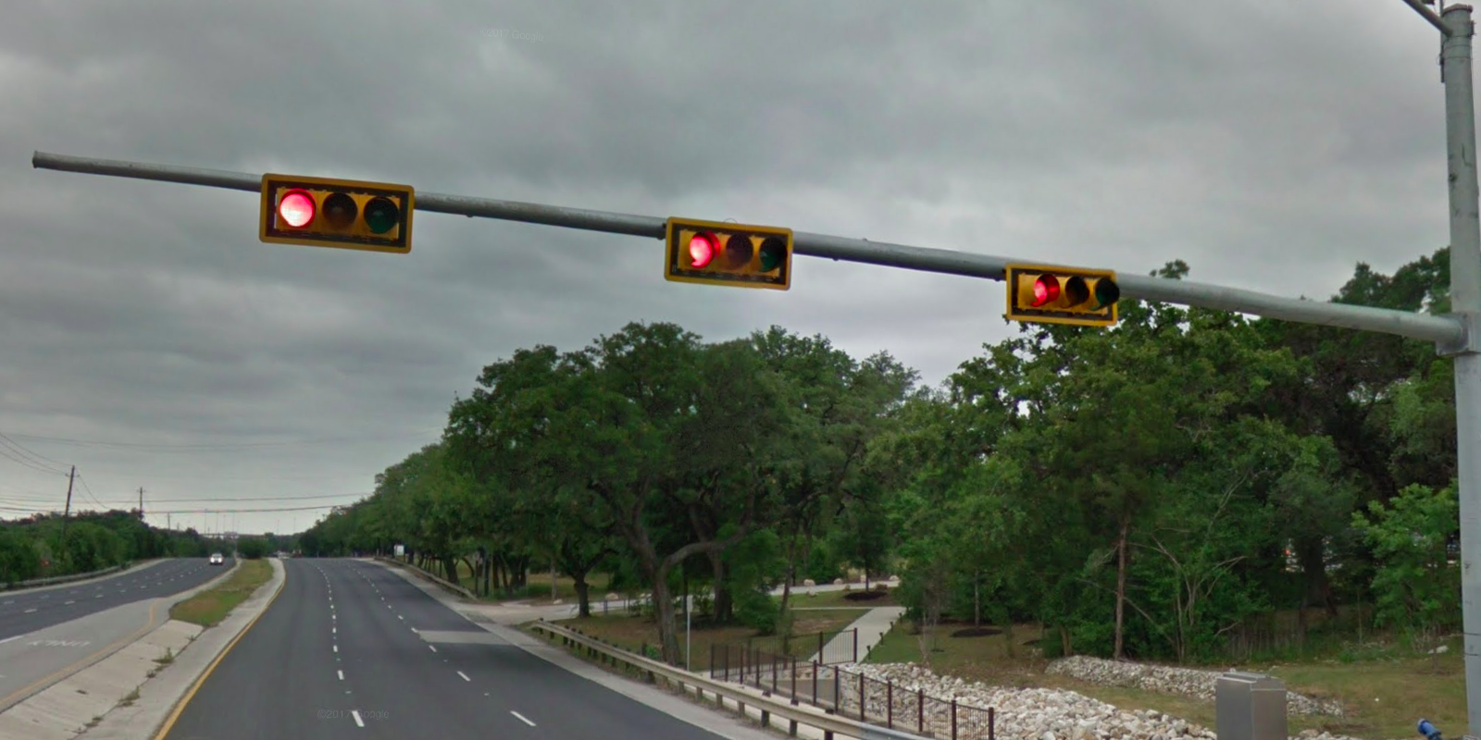
Austin Transportation Department Signs Work Orders
Created By: Susanne Gov Created Date: 2020-08-10 Location Name: 5613 BLK SOUTHWEST PKWY (Encino Trace Office Park) Intersection ID: 0 Cardinal Direction: E
Sign Type | Install/Remove
 | Install

Slide 4
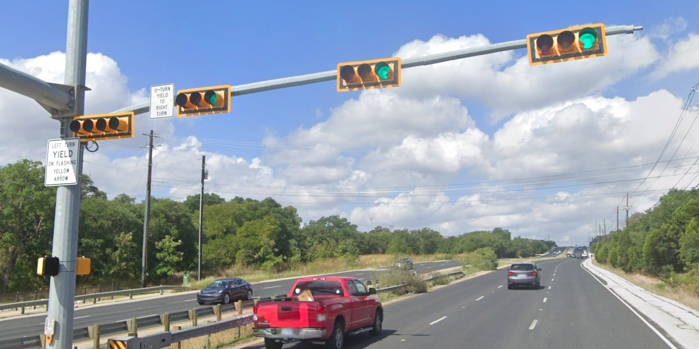
Austin Transportation Department Signs Work Orders
Created By: Susanne Gov Created Date: 2020-08-10 Location Name: 5613 BLK SOUTHWEST PKWY (Encino Trace Office Park) Intersection ID: 0 Cardinal Direction: W
Sign Type | Install/Remove
Left Turn Yield Flashing Yellow | Install
U Turn Yield to Right Turn | Install

